Slide 1
…

Slide 2
Make It Easy For Borrowers To Understand Your Loan Proposals With The LoanQConnect Mortgage Calculator

Slide 3
LoanQConnect Mortgage Calculator Mobile Applications For The Mortgage Industry
Fixed Rate Loan Quotes Made Easy
From Your Phone Or Tablet
Any Time, Any Where
Send A “Quote PDF” While
Speaking With Borrowers
Mine Valuable Contact Information

Slide 4
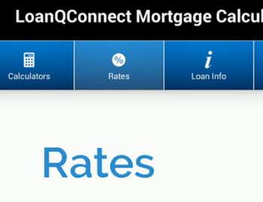
Charles Nenner Research Center Benefit From The Power of Algorithms Provided by the World Leader in Bond and Stock Market Forecasting
Make Better Lock Decisions
Be Proactive - Don’t Get Caught Flat Footed
Get Up To Date Lock Forecast Information with
~ Monday, Wednesday, Friday Updates
Receive Push Notifications About Changes In Rates and Market Conditions
Rate Module Tab Included w/ Subscription
Your Clients Will Love It When You Save Them Money with a Better Rate Using LoanQConnect

Slide 5
Inexpensive And Powerful A Great Value at Only $4.99 Per Month(+ Tax)
Features of the LoanQConnect App
MLO Easy Setup – One Time MLO and Company Compliance Setup
Used For All Emails & “Quote PDF” Files Sent To Clients
Add a Photo, Logo or vCard Once For All E-mails & Loan Quotes
Send a “Quote PDF” File From Any Mobile Device, Any Time, Any Where
Get Mortgage Rate Forecast Guidance with Data Provided By the
Charles Nenner Research Center
Benefits
LoanQConnect Truly Brings “The Office To The Road”!
Impress Borrowers and Realtors w/ New MLO Technology
Mine Valuable Client Information and Close More Loans
Form a Better Partnership with Your Realtors and Borrowers
Price and Terms
$4.99 / Month (+ Tax) – Get a Monthly or Yearly Subscription
Cancel at Any Time - No Contracts & No Commitments
Use Leading Edge Technology
Close More Loans

Slide 6
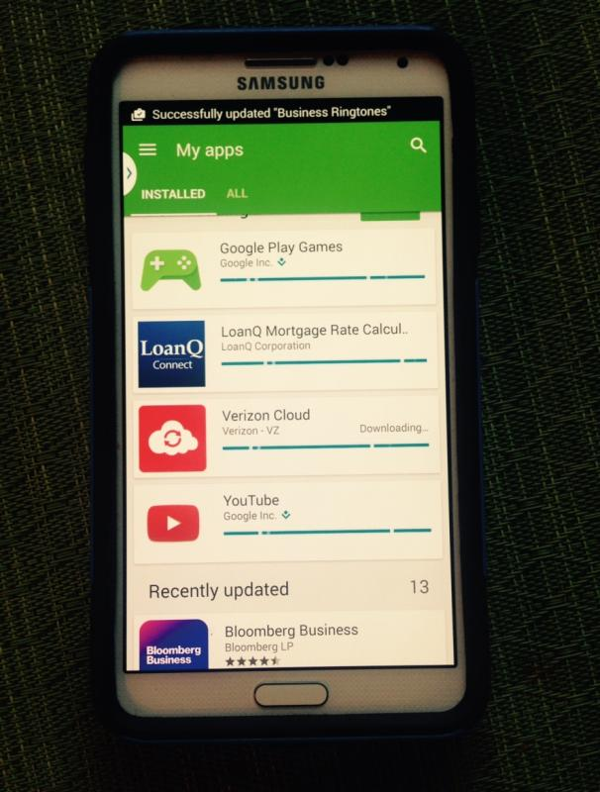
LoanQConnect App Will Stay Updated and Current
No Need To Develop An In House App!
LoanQConnect Will Keep This App Updated and Current with The Latest Technology
We Manage The App While You and Your Team Originate and Close New Loans
Get New Calculators and Enhancements
Coming Soon! Illustration of Closing Costs
Get The Latest Rate Information with Our Secure “Rates” Module Tab - It’s Awesome!
All For
$4.99 Per Month Per MLO (+ Tax)

Slide 7
Inexpensive And Powerful A Great Value at Only $4.99 Per Month (+ Tax)
Use Leading Edge Technology To
Close More Loans
Bring “The Mortgage Office To The Road”!
Impress Your Realtors and Your Borrowers
Make Every Client Contact Count
Send Your Contact Information on Your
“Quote PDF” File From Your Mobile Device
Billed Monthly or Yearly Thru Google or Apple
No Contracts – No Commitments

