Slide 1
…

Slide 2
LoanQConnect Is Easy To Use Build Powerful Loan Presentations Share Your Contact and Loan Info Any Where, Any Time Become A Top MLO With A Greater Slice Of The Pie!

Slide 3
Inexpensive And Powerful A Great Value at Only $4.99 Per Month(+ Tax)
Features
MLO Easy Setup - Registration and Company Compliance Info
For All Emails & Loan Quote PDF Sent To Clients
Add a Photo, Logo or vCard Once For All E-mails & Loan Quotes
Send a Quote PDF File From Any Mobile Device, Any Time, Any Where
Charles Nenner Research Center Interest Rate & Lock Guidance
Benefits
Truly Brings The Office To The Road!
Impress Borrowers and Realtors w/ New Technology
Send Your Loan Quote While Mining Valuable Client Information
Know What Interest Rates Are Doing, When To Lock & When To Float
Price and Terms
$4.99 / Month (+ Tax) – Get a Monthly or Yearly Subscription
Cancel at Any Time - No Contracts & No Commitments
Use Leading Edge Technology Close More Loans

Slide 4
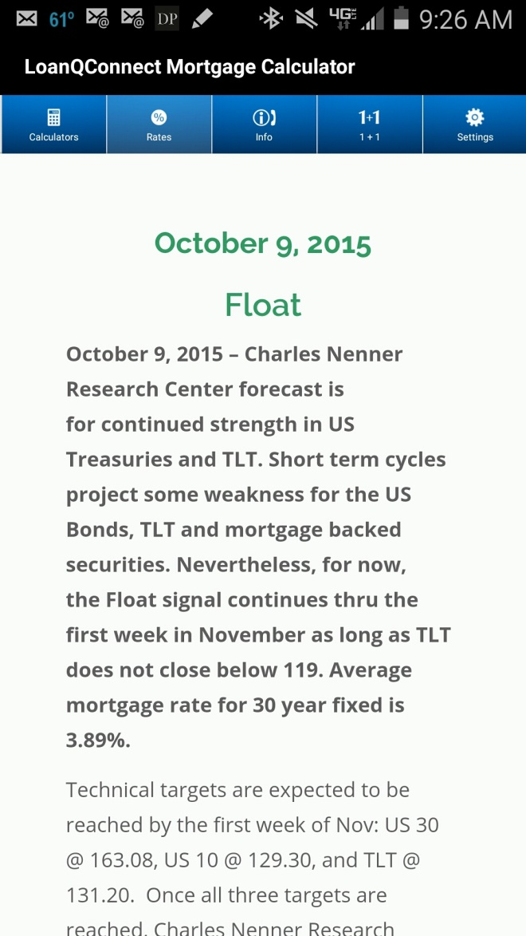
Charles Nenner Research Center Benefit From The Power of Algorithms Provided by the World Leader in Bond and Stock Market Forecasting
Make Better Lock Decisions
Be Proactive - Don’t Get Caught Flat Footed
Get Up To Date Lock Forecast Information with
~ Monday, Wednesday, Friday Updates
Receive Push Notifications About Changes In Rates and Market Conditions
Rate Module Tab Included w/ Subscription
Your Clients Will Love It When You Save Them Money with a Better Rate Using LoanQConnect

Slide 5
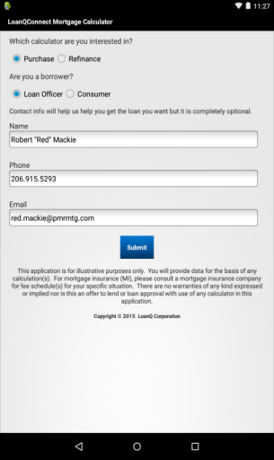
First Step - Registration Always Optional But A Must For MLO’s
Register Once On Install – It’s Easy:
Select – Initial Use of Purchase or Refinance
Select – MLO or Consumer
Add Your Contact Information
MLO: Registration Helps with State and Federal Compliance but You Must Complete Separate Company Section to be Completely In Compliance!
Click “Submit” to Accept and Install

Slide 6
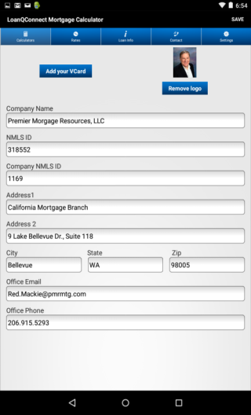
MLO Registration - Second Step Complies With Current Regulations
Enter Company Data for Compliance
Add All Your Company Information
Customize By Using a vCard Image, Logo or Personal / Team Photo
Complete Business Information Section for Compliance
Click “Save” and Start Using
It’s Fast and Easy To Setup!
The App Uses These Data Points and Image(s) On All Emails and In All Documents!

Slide 7
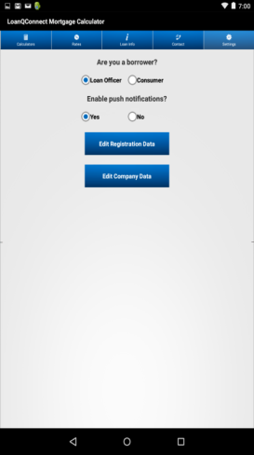
Edit Your Contact Information
So Quick, So Easy in the LoanQConnect Settings Tab!
Change Push Notification Acceptance
Edit Your Personal Information
Edit Company Information
Make Changes About New Employment
Update Your Personal/Team Photo
Add a Company Logo
Use a vCard Image
It’s Fast, Friendly and Easy To Use!

Slide 8
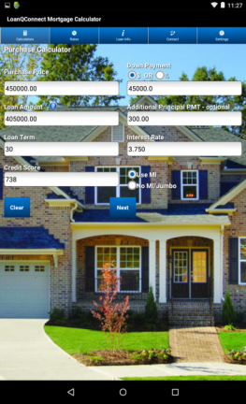
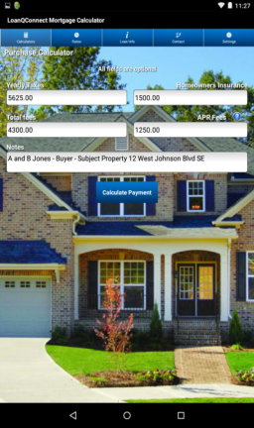
Easy Purchase or Refinance Data Entry Enter Relevant Fixed Rate Information
Easy To Complete Loan Information For Maximum Impact. Takes Less Than One Minute!
Enables You To Maximize Your Client Contact Opportunities and Close More Loans!
Great Benefits for You, Your Borrowers and Your Realtors!
Borrower-Specific Loan Quotes
Connect w/ Concise Information
Timely and Accurate Estimates
Add Notes to Your Quote About Your Realtor, the Property, the Loan, or About the Borrower
Your Borrowers Are Going To Love You For Using This App

Slide 9
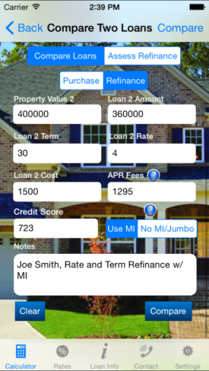
Use 5 Calculators Including Compare Two Loans And Assess Your Refinance
Make It Easy For Your Borrowers To Choose The Right Loan

Slide 10
Input The Salient Loan Information
Input Property Value Use Down Payment Amount In $ or %
Change The Loan Amount Enter Additional Principal Payment
State The Loan Term Quote The Interest Rate
Base MI On Borrower Quote Loans >80% LTV with MI or No MI
Credit Scores

Slide 11
Add These Purchase or Refinance Data Points Send A Complete Loan Estimate
Add Yearly Property Taxes Add Annual Home Owners Insurance
Enter Your Closing Costs Input Total APR Fees for APR Calculation
Notes: Add Important Info
for Your Borrower About Calculate Payment
You, the Loan or Your Realtor

Slide 12
Review Your Estimate Before Sending Make sure you are sending the correct loan information.

Slide 13
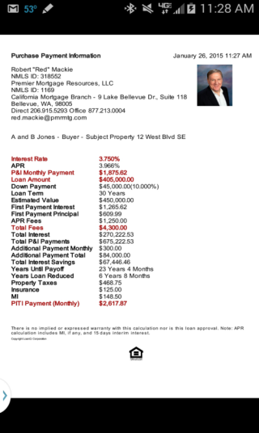
Make A Great Impression with the LoanQConnect App
You Will Have the Ability To:
Quickly Create a “Quote PDF” for E-Mail, Air Drop or Save for Later Reference
Send A Comprehensive “Quote PDF” File with All Your Contact Information
Multiple Calculator Options for Easy Loan Decision Making :
Easily Compare 2 Loans
Compare Existing with a New Proposed Loan
Single Quotes for Purchase or Refinance
Quick Calculator for P & I Payment Only
Coming Soon! Detail Illustration of Closing Costs
Send Current and Usable Data Any Time
Calculate the Power of Extra Principal Payments Each Month

Slide 14
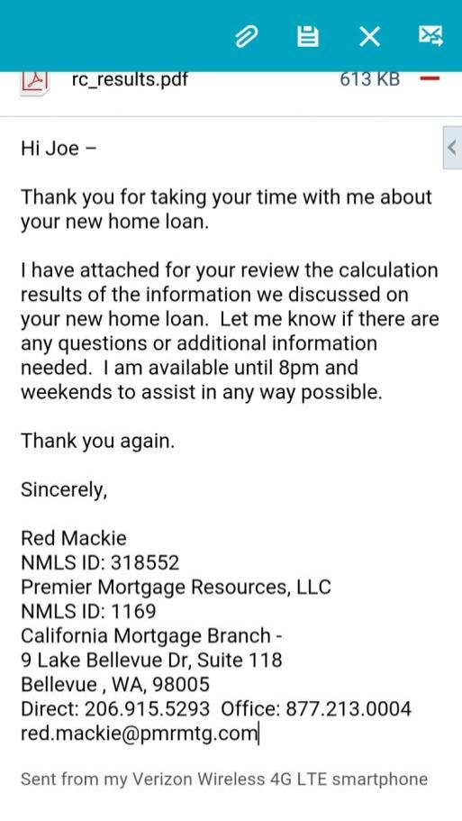
Customize Your Email
Your LoanQConnect App Creates an E-Mail with
Customizable Introduction
“Quote PDF” File Attachment
Your Complete Contact Information
Regulation Compliance In Mind
Coming Soon - Detailed Illustration of Closing Costs
Your LoanQConnect App E-Mail Allows You To
Make The Most of Your Contact Time
Promote You and Your Realtor
Be More Efficient
Use “The Mortgage Office On The Go”
Send Quotes From a Single Device
Be More Productive In a Day
Originate and Close More Loans
All For Just $4.99 Per Month (+Tax)

Slide 15
Inexpensive And Powerful A Great Value at Only $4.99 Per Month (+ Tax)
Use Leading Edge Technology To
Close More Loans
Impress Your Realtors and Your Borrowers
Make Every Client Contact Count
Send Your Quote and Contact Information Together While Speaking with Clients
Brings The Office To The Road!
iTunes Billed Monthly
Monthly or Annually Thru Play
No Contracts – No Commitments

